Slide 1

Disease detection
180030889-PUJITHA
180030882-LALASA

Slide 2
MAIN STEPS
AGE GROUP PREDICTION
TYPE OF PREDECTION
ANALYSIS

Slide 3
ABSTRACT:
The use of Machine Learning (ML) in Medicine is nowadays becoming more and more important. Researchers are now using ML in applications such as EEG analysis and Cancer Detection/Analysis. For example, by examining biological data such as DNA methylation and RNA sequencing can then be possible to infer which genes can cause cancer and which genes can instead be able to suppress its expression. In this post, I will walk you through how I examined 9 different datasets about TCGA Liver, Cervical and Colon Cancer. All the datasets have been provided by the UCSC Xena (University of California, Santa Cruz website). For each of the 3 different types of cancer considered, three datasets were used, containing information about DNA methylation (Methylation450k), gene expression RNAseq (IlluminaHiSeq) and finally exon expression RNAseq (IlluminaHiSeq). These datasets are then grouped by information type rather than by cancer.

Slide 4
I decided to use these datasets because they had all their features in common and shared a similar number of samples. Furthermore, I decided to select these types of cancers, because they offered a varied view of the genes and chromosomes characteristics of the human body since the different cancers were located in different parts of the body. In this way, the classification results obtained in this exercise could be generalized to other forms of cancer. DNA methylation plays an important role in the regulation of gene expression, and its modification can either result in generation or suppression of cancerous cells.

Slide 5
Classification:
Each of the datasets had to be transposed and pre-processed. After forming the final three datasets, the classification between the different types of cancers was performed. In order to produce these results, a 70% training, 30% test split ratio was used. As shown in Table, many classifications algorithms were considered. These results were obtained making use of the whole datasets and the classifiers aimed to correctly distinguish between the three different types of cancer.

Slide 6
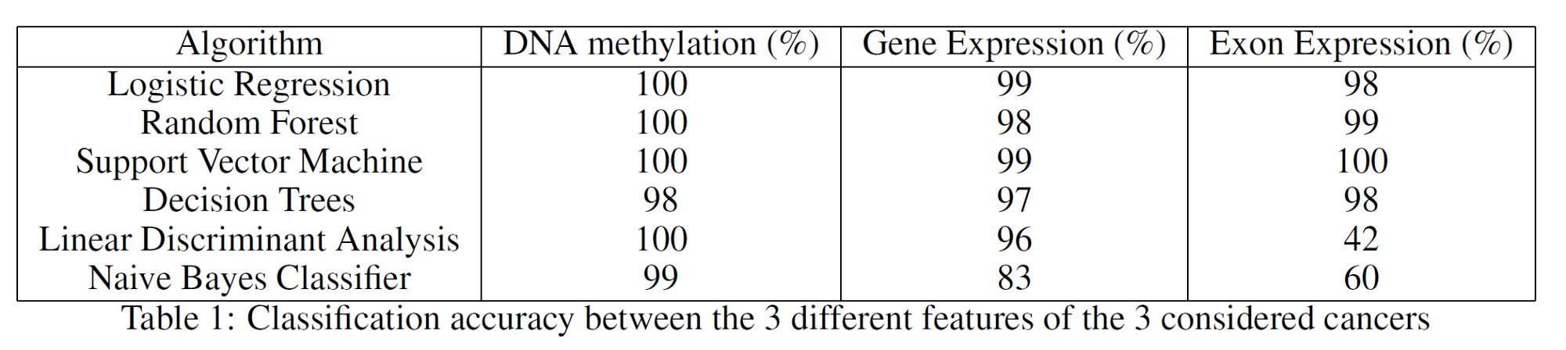

Slide 7
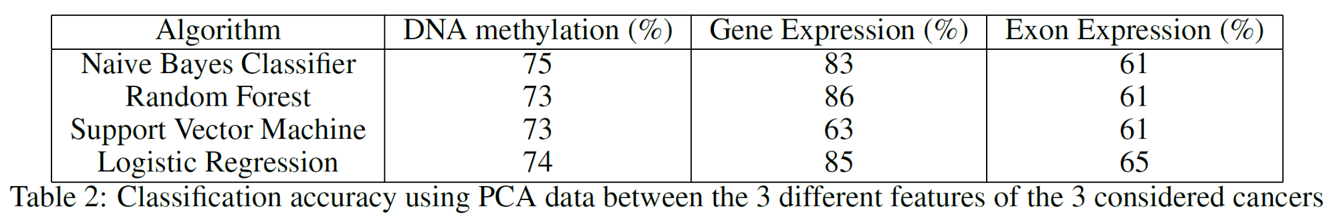
Feature Extraction
I performed Principal Component Analysis (PCA) on the 3 given datasets to see how the classification accuracy results would be affected by using just the first two principal components. PCA aims to reduce the dimensionality of a dataset while preserving as much variance as possible. As can be noticed from Table, reducing the data dimensionality to just two features didn’t lead to a drastic decrease in accuracy.

Slide 8
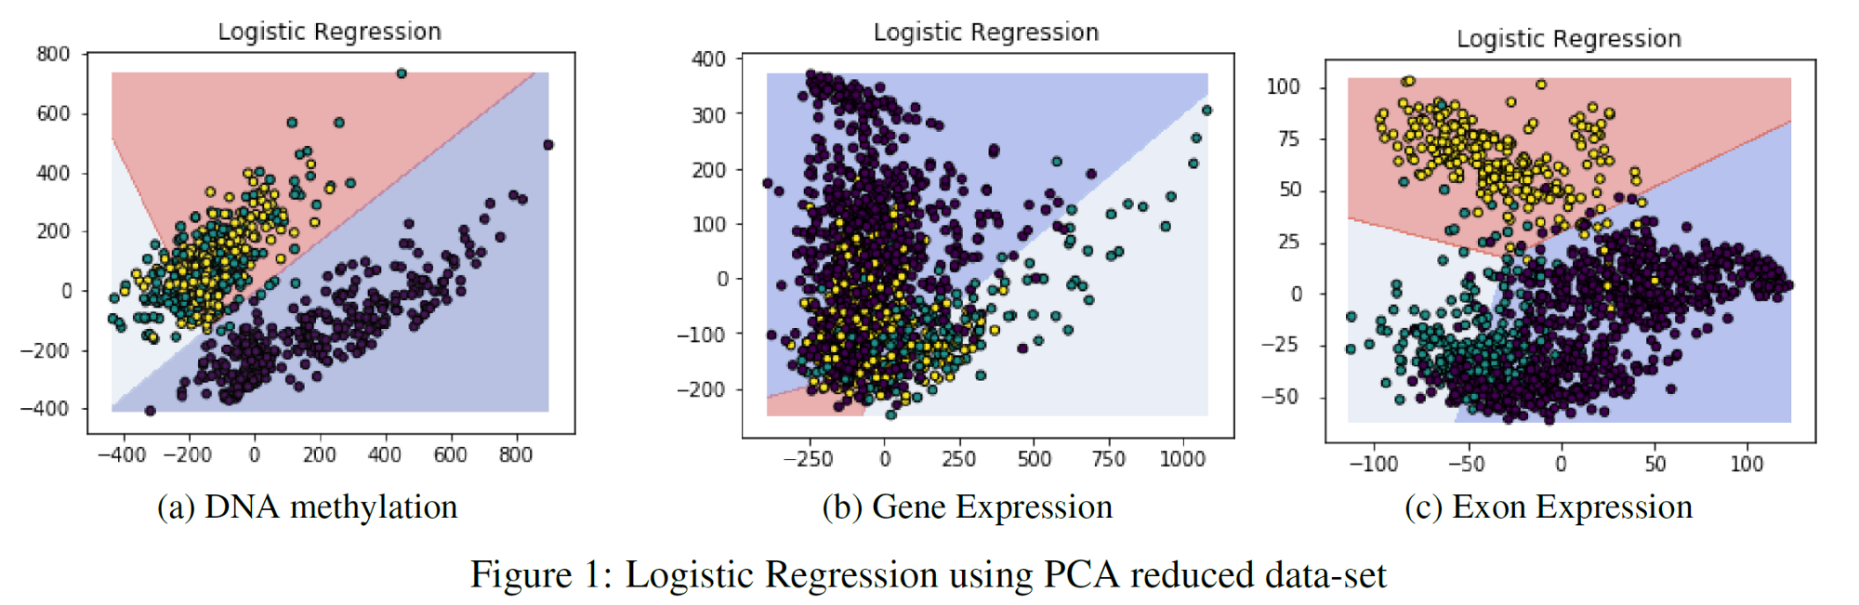

Slide 9
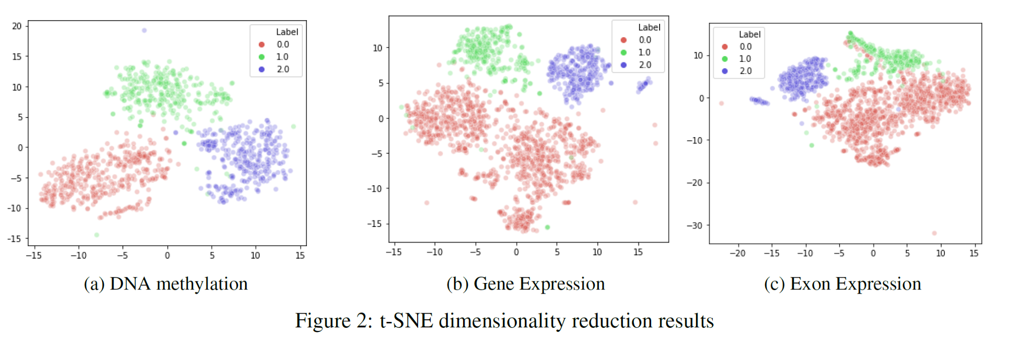

Slide 10
Feature Selection
The previous sections showed us that using the whole datasets it was possible to achieve really good classification results. Using feature extraction techniques such as PCA and t-SNE, it has then been shown that it is possible to reduce dimensionality whilst still yielding an appreciable classification score. Thanks to these results, I then decided to plot a decision tree representing the main features (the ones holding the biggest weights) used in classification to take a closer look at most important ones. I decided to use a Decision Tree for analysis due to its classification performance in all three datasets. The results can be seen in decision trees.

Slide 11
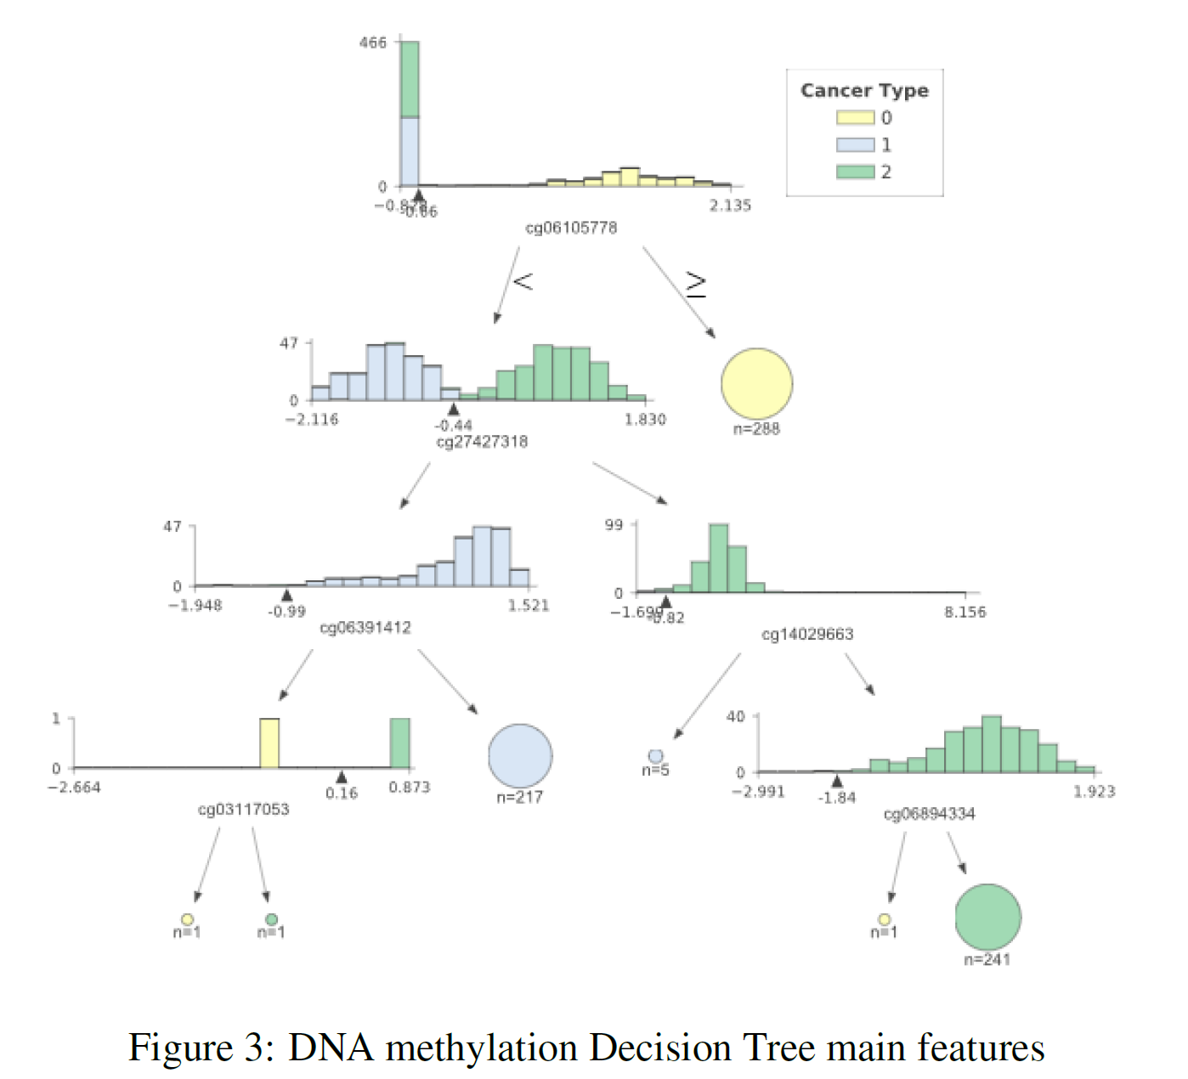

Slide 12
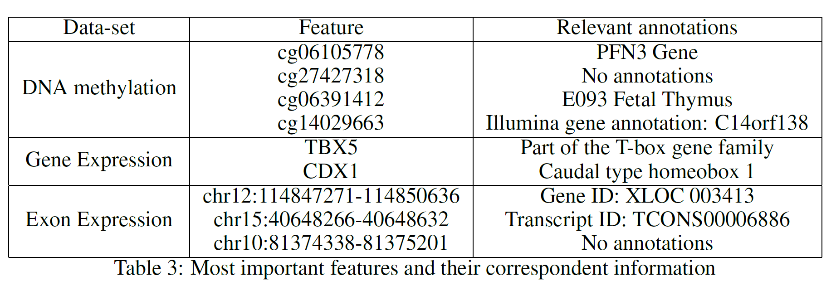
Evaluation:
Table provides a summary of the features used at the top (first two levels) of the three different trees. After careful research, looking into online available databases, a series of relevant annotations have been added for each of the features. In the case of cg27427318 and chr10:81374338–81375201 it was not possible to find any relevant information.

Slide 13
Conclusion:
Overall this project lead to really good results. The aim of the research is to analyze, review, categorize and address the current developments of human body cancer detection using machine learning techniques for breast, brain, lung, liver, skin cancer leukemia. The study highlights how cancer diagnosis, cure process is assisted using machine learning with supervised, unsupervised and deep learning techniques. As further development, it would be interesting to try alternative Feature Selection techniques such as Recursive Feature Selection (RFS) or SVM (as explained in this my other post) to see if other types of genes/chromosomes can be identified. Another possible improvement to this analysis could be to use datasets containing data from healthy subjects as well to cross-validate the obtained results.

Slide 14
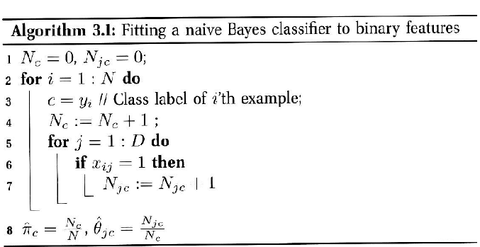
Naive Bayes Classifier

Slide 15
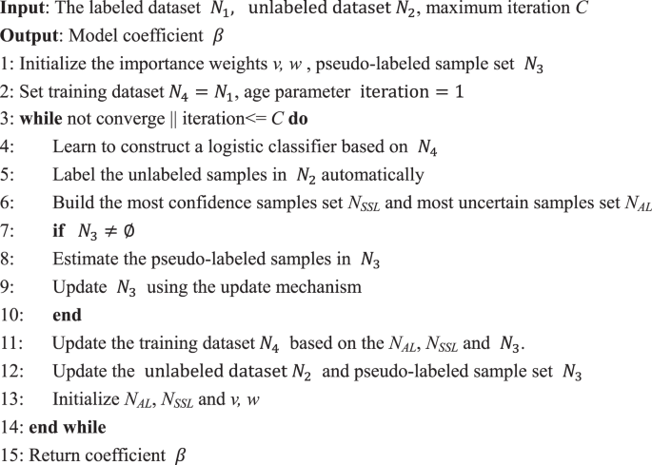
Logistic Regression

Slide 16
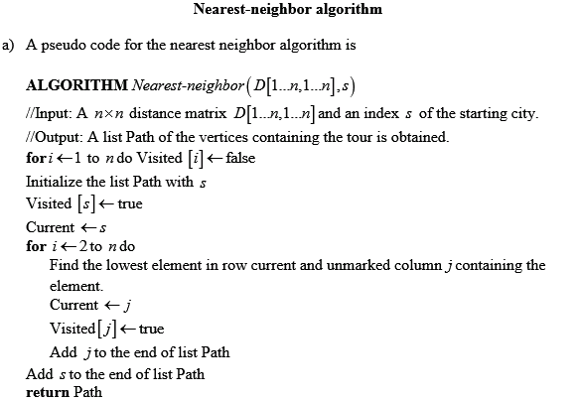
K – Nearest Neighbour Classifier

Slide 17
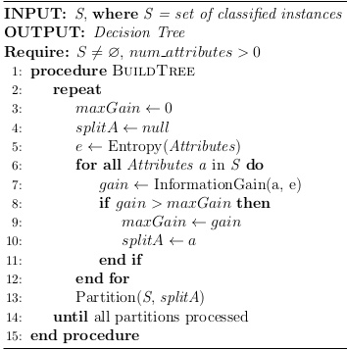
Decision Tree Classifier

